Slide 1
String Methods
The strip() method removes any whitespace from the beginning or the end
Example
a = " Hello, World! " print(a.strip())

Slide 2
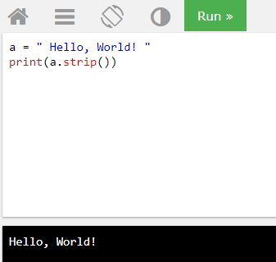
Output

Slide 3
lower() method
The lower() method returns the string in lower case
Example
a = "Hello, World!" print(a.lower())

Slide 4
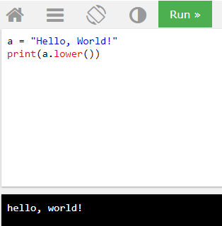
Output

Slide 5
upper() method
The upper() method returns the string in upper case
Example
a = "Hello, World!" print(a.upper())

Slide 6
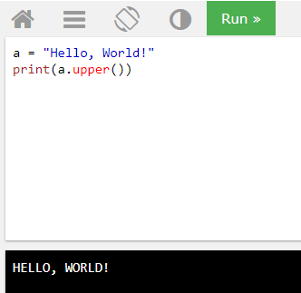
Output

Slide 7
replace() method
The replace() method used to replace character
Example:
a = "Hello, World!" print(a.replace("H", "J"))

Slide 8
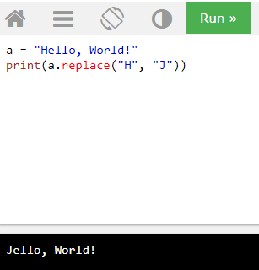
Output

Slide 9
split() method
The split() method splits the string into substrings if it finds instances of the separator
Example
a = "Hello, World!" print(a.split(","))
Print(b)

Slide 10
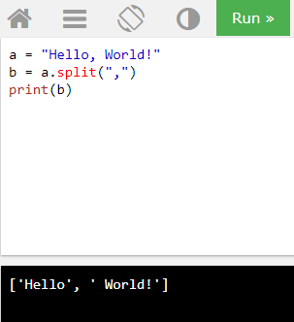
Output

Slide 11
Check String
To check if a certain phrase or character is present in a string, we can use the keywords in or not in
Example
Check if the phrase "ain" is present in the following text:
txt = "The rain in Spain stays mainly in the plain" x = "ain" in txt print(x)

Slide 12
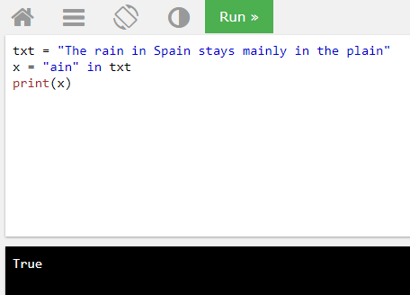
Output

Slide 13
Check String
To check if a certain phrase or character is present in a string, we can use the keywords in or not in
Example
Check if the phrase "ain" is NOT present in the following text:
txt = "The rain in Spain stays mainly in the plain" x = "ain" in txt print(x)

Slide 14
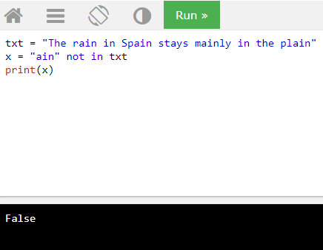
Output

Slide 15
#write a program to input two strings. If string1 is contained in tring2, then create a third string with first four characters of string2’ added with word ‘restore’.
s1=input ("enter string1:")
s2=input("enter string2:")
print("original strings:",s1,s2)
if s1 in s2:
s3=s2[0:4]+'restore'
print("final string:",s1,s3)

Slide 16
output:
enter string1:rin
enter string2:shagrin
original strings: rinshagrin
final string: rinshagrestore

Slide 17
# write a program to input a string and check if it is a palindrome string using a string slice
s=input("Enter a string:")
if(s==s[::-1]):
print(s, "is a Palindrome.")
else:
print(s,"is NOT a Palindrome.")

Slide 18
Enter a string:madam
madam is a Palindrome.

Slide 19
# len function
name="Maria"
L=len(name)
print(L)

Slide 20
5

Slide 21
p='i love my india'.capitalize()
print(p)

Slide 22
I love my india

Slide 23
Count
t='abracadabra'.count('ab')
print(t)
Output:
2

Slide 24
string="it goes as-ringa ringa roses"
sub="ringa"
s=string.find(sub)
print(s)
Output:
11

Slide 25
String Concatenation
To concatenate, or combine, two strings you can use the + operator
Example
Merge variable a with variable b into variable c:
a = "Hello"
b = "World"
c = a + b
print(c)

Slide 26
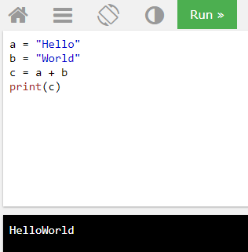
Output

Slide 27
Example
To add a space between them, add a " “
a = "Hello" b = "World" c = a + " " + b print(c)

Slide 28
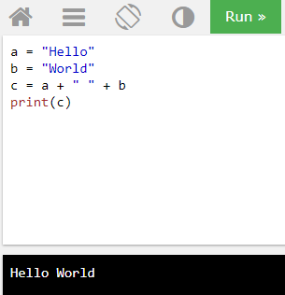
Output

Slide 29
String Format
Python Variables, we cannot combine strings and numbers
Example
age = 36 txt = "My name is John, I am " + age print(txt)

Slide 30
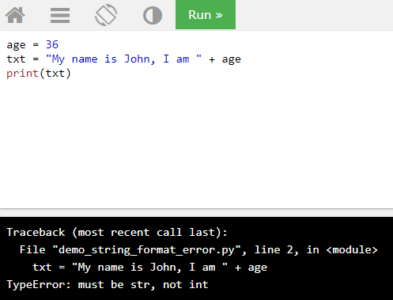
Output

Slide 31
format() method
combine strings and numbers by using the format() method!
The format() method takes the passed arguments, formats them, and places them in the string where the placeholders {} are:

Slide 32
Example
age = 36 txt = "My name is John, and I am {}" print(txt.format(age))

Slide 33
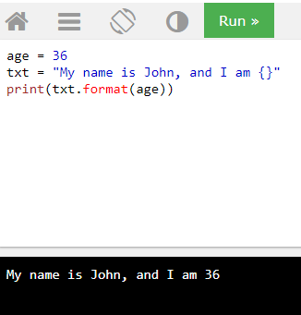
Output

Slide 34
Example
quantity = 3 itemno = 567 price = 49.95 myorder = "I want {} pieces of item {} for {} dollars." print(myorder.format(quantity, itemno, price))

Slide 35
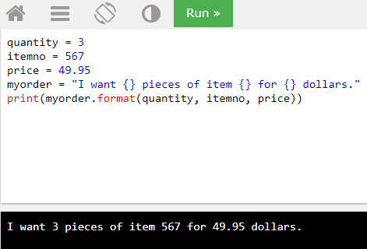
Output

Slide 36
Index numbers
index numbers {0} to be sure the arguments are placed in the correct placeholders
Example:
quantity = 3 itemno = 567 price = 49.95 myorder = "I want to pay {2} dollars for {0} pieces of item {1}." print(myorder.format(quantity, itemno, price))

Slide 37
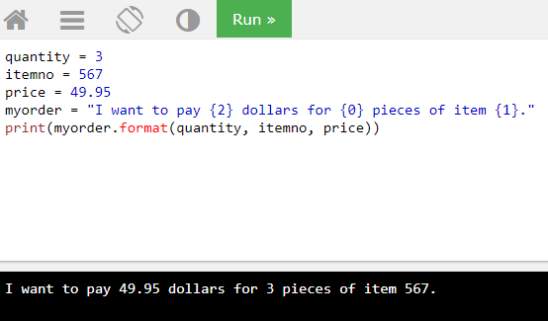
Output

Slide 38
Escape Character
To insert characters that are illegal in a string, use an escape character.
An escape character is a backslash \ followed by the character you want to insert
Example
txt = "We are the so-called "Vikings" from the north."

Slide 39
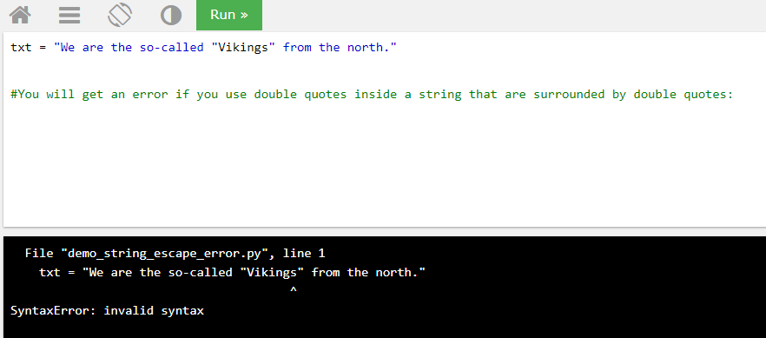
Output

Slide 40
string1=input("enter a string:")
print("The",string1,"in reverse order is:")
length=len(string1)
for a in range(-1,(-length-1),-1):
print(string1[a])

Slide 41
enter a string:python
The python in reverse order is:
n
o
h
t
y
p

Slide 42
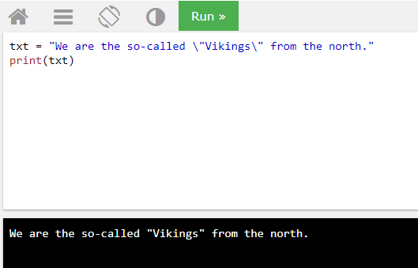
To fix this problem, use the escape character \"
Example:
txt = "We are the so-called \"Vikings\" from the north."
Output:

Slide 43
Replication operator
t="abd"*8
print(t)
Output:
abdabdabdabdabdabdabdabd

Slide 44
Slicing
word="amazing"
t=word[0:3]
print(t)
Output:
ama

Slide 45
word="amazing"
t=word[:5]
print(t)
Output:
amazi

Slide 46
Ctd…
word="amazing"
t=word[-5:-2]
print(t)
Output:
azi

Slide 47
word="amazing"
t=word[-6:-1]
print(t)
Output:
mazin

Slide 48
word="amazing"
t=word[1:6:2]
print(t)
Output:
mzn

Slide 49
word="amazing"
t=word[-6:-3:3]
print(t)
Output:
m

Slide 50
word="amazing"
t=word[: : 3]
print(t)
Output:
azg

Slide 51
word="amazing"
t=word[: : -3]
print(t)
Output:
gza

Slide 52
string="abc123"
string2="hello"
string3="12345"
string4=" "
an=string.isalnum()
print(an)
Output:
True

Slide 53
string="abc123"
string2="hello"
string3="12345"
string4=" "
an=string.isalnum()
a=string2.isalpha()
print(a) output:
True

Slide 54
string="abc123"
string2="hello"
string3="12345"
string4=" "
a=string3.isdigit()
print(a)
Output:
True

Slide 55
string="hello"
string2="There"
string3="Goldy"
p=string.islower()
print(p)
Output:
True

Slide 56
string="hello"
string2="There"
string3="GOLDY"
p=string3.isupper()
print(p)
OUTPUT:
True

Slide 57
string=" "
string2=""
p=string.isspace()
print(p)
Output:
True

Slide 58
string=" "
string2=""
p=string2.isspace()
print(p)
Output:
False

Slide 59
p="abcd".startswith("cd")
print(p)
Output:
False

Slide 60
t="*".join("Hello")
print(t)
Output:
H*e*l*l*o

Slide 61
p="abcd".endswith("cd")
print(p)
Output:
True

Slide 62
t=" I enjoy working in python"
x=t.partition("working")
print(x)
Output:
(' I enjoy ', 'working', ' in python')

Slide 63
#write a program to input an integer and check if contains any 0 in it.
n=int(input("Enter a number:"))
s=str(n)
if '0' in s:
print("There's a 0 in",n)
else:
print("No 0 in ",n)

Slide 64
Output:
Enter a number:5678
No 0 in 5678
Enter a number:4507
There's a 0 in 4507

Slide 65
#An easy way to print a blank line is print().However,To print ten blank lines ,would you write print() ten times? Or is there a smart Alternative? If yes,write code to print a line with 30 ‘=‘ characters followed by ten blank lines and another line with 30 ‘=‘ characters.
print("=" *30)
print("\n" *9)
print("=" *30)

Slide 66
==============================
==============================

Slide 67
#write a program that asks a user for a username and a code.Ensure that the user doesn't use their username as part of their code
uname=input("Enter username:")
code=input("Enter code:")
if uname in code:
print("your code should not \
contain your user name.")
print("Thank you")

Slide 68
Enter username:vaidya
Enter code:121vaidyanathanakash
your code should not contain your user name.
Thank you

Slide 69
Enter username:vaidya
Enter code:123Vaidya

Slide 70
#That asks a user for a username and a pcode.Make sure that pcode doesn't contain username and matches 'Trident111'.
uname=input("Enter username")
pcode=input("Enter code:")
if uname not in pcode and pcode == 'Trident111':
print("Your code is valid to proceed.")
else:
print("your code is not valid")

Slide 71
Output:
Enter username Akash
Enter code:Trident111
Your code is valid to proceed.
>>>

Slide 72
#program that prints the following pattern without using any nested loop
string=':)'
pattern=" "
for a in range(5):
pattern+=string
print(pattern)

Slide 73
:)
:):)
:):):)
:):):):)
:):):):):)

Slide 74
#program that reads a line and prints its statistics like:
line=input("Enter a line:")
lowercount=uppercount=0
digitcount=alphacount=symcount=0
for a in line:
if a.islower():
lowercount+=1
elif a.isupper():
uppercount+=1
elif a.isdigit():
digitcount+=1

Slide 75
elif a.isalpha():
alphacount+=1
elif a.isalnum()!=True and a!=' ':
symcount+=1
print('number of uppercase letters:',uppercount)
print('number of lowercase letters:',lowercount)
print('number of alphabets:',alphacount)
print('number of digits:',digitcount)
print('number of symbols:',symcount)

Slide 76
Enter a line:hello word I WAS CHECKING UR SKILLS
number of uppercase letters: 20
number of lowercase letters: 9
number of alphabets: 0
number of digits: 0
number of symbols: 6
>>>

Slide 77
#program that reads a line and a substring.It should then display the number of occurences of the
#given substring in the line
line=input("Enter line:")
sub=input("enter substring:")
length=len(line)
lensub=len(sub)
start=count=0

Slide 78
end=length
while True:
pos=line.find(sub,start,end)
if pos!=-1:
count+=1
start=pos+lensub
else:
break
if start >= length:
break
print("No of occurence of",sub,':',count)

Slide 79
Enter line:jingle bells jingle bells jingle on the way
enter substring:jingle
No of occurence of jingle : 3

Slide 80
#program that inputs a string that contains a decimal number and prints out the decimal part
#of the number.For instance,if 515.8059 is given,the program should print out 8059.
s=input("Enter a string (a decimal number):")
t=s.partition('.')
print("Given string:",s)
print("part after decimal",t)

Slide 81
Enter a string (a decimal number):515.8055
Given string: 515.8055
part after decimal ('515', '.', '8055')

Slide 82
#program that inputs a string that contains a decimal number and prints out the decimal part
#of the number.For instance,if 515.8059 is given,the program should print out 8059.
s=input("Enter a string (a decimal number):")
t=s.partition('.')
print("Given string:",s)
print("part after decimal",t[2])

Slide 83
Enter a string (a decimal number):515.8059
Given string: 515.8059
part after decimal 8059

Slide 84
# A program that inputs individual words of your school motto and joins them to make a string.It shouls also input day,month and year of your school’s foundation date and print the complete date.
print("Enter words of your school motto,one by one")
w1=input("Enter word1:")
w2=input("Enter word2:")
w3=input("Enter word3:")
w4=input("Enter word4:")
motto=" ".join([w1,w2,w3,w4])
print("Enter your school's foundation date")
dd=input("Enter dd:")

Slide 85
mm=input("Enter mm:")
yyyy=input("Enter yyyy:")
dt="/".join([dd,mm,yyyy])
print("School motto:",motto)
print("school foundation date:",dt)

